Slide 1
Data warehouse

Slide 2
Introduction
Cloud data warehouse provide more powerful
Computing that supports streaming data, allowing
Query data in real time.As a result you can access
And use data much faster than with an on premise data warehouse.allowing you to get more accurate insights faster and make more informed
Business decisions
Notes:
Cloud data warehouse provide more powerful
Computing that supports streaming data, allowing
Query data in real time.As a result you can access
And use data much faster than with an on premise data warehouse.allowing you to get more accurate insights faster and make more informed
Business decisions

Slide 3
Data warehouse
A data warehouse is a central repository of information that can be analyzed to make more informed decisions. Data flows into a data warehouse from transactional systems, relational databases, and other sources, typically on a regular cadence. Business analysts, data engineers, data scientists, and decision makers access the data through business intelligence (BI) tools, SQL clients, and other analytics applications

Slide 4
Cloud data warehouse
A cloud data warehouse is a database delivered in a public cloud as a managed service that is optimized for analytics, scale and ease of use.

Slide 5
Why we use cloud data warehouse
A cloud data warehouse can make it easier for team members to collaborate on data projects. That's because most cloud data warehouses offer a web-based interface that makes it easy to access, query, and visualize data. This can help you get insights faster and make better decisions about your business.

Slide 6
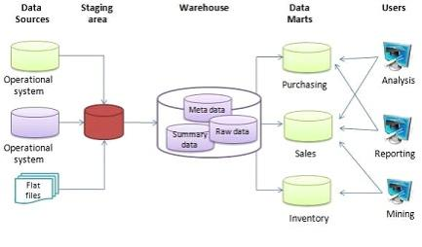
Architecture of cloud data warehouse
Notes:
Architecture of cloud data warehouse

Slide 7
Traditional Vs Cloud data warehouse
Cloud-based data warehouses are the new norm. Gone are the days where your business had to purchase hardware, create server rooms and hire, train, and maintain a dedicated team of staff to run it. Now, with a few clicks on your laptop and a credit card, you can access practically unlimited computing power and storage space.However, this does not mean that traditional data warehouse ideas are dead. Classical data warehouse theory underpins most of what cloud-based data warehouses do.In this article, we’ll explain the traditional data warehouse concepts you need to know and the most important cloud ones from a selection of the top providers: Amazon, Google, and Panoply. Finally, we’ll wrap up with a cost-benefit analysis of traditional vs. cloud data warehouses, so you know which one is right for you.
Notes:
Traditional Vs Cloud data warehouse

Slide 8
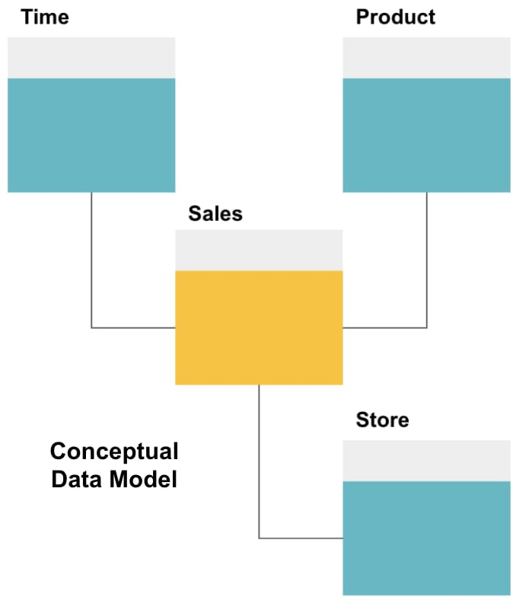
Data model
Notes:
Data model

Slide 9
Advantage and disadvantage
Disadvantage
time and cost
Advantage
1.Low cost electricity
2.The cloud itself
3.More secure data
4.Better disaster recovery
5.Increase storage
Notes:
Disadvantage
time and cost
Advantage
1.Low cost electricity
2.The cloud itself
3.More secure data
4.Better disaster recovery
5.Increase storage

Slide 10
Code of data warehouse
Crete dimensions table:CREATE TABLE Dim_Customer ( CustomerID INT PRIMARY KEY, CustomerName VARCHAR(255), ...);CREATE TABLE Dim_Product ( ProductID INT PRIMARY KEY, ProductName VARCHAR(255), ...);
Create database: CREATE DATABASE DataWarehouse;USE DataWarehouse;
Create fact table:CREATE TABLE Fact_Sales ( TransactionID INT PRIMARY KEY, CustomerID INT, ProductID INT, TransactionDate DATE, Amount DECIMAL(10, 2), ...);

Slide 11
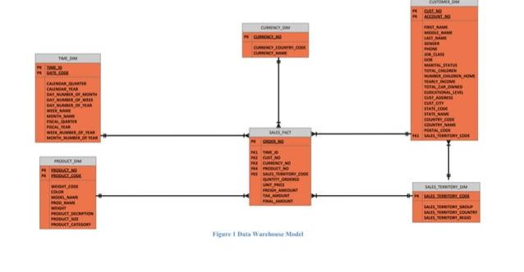
Data warehouse schema

Slide 12
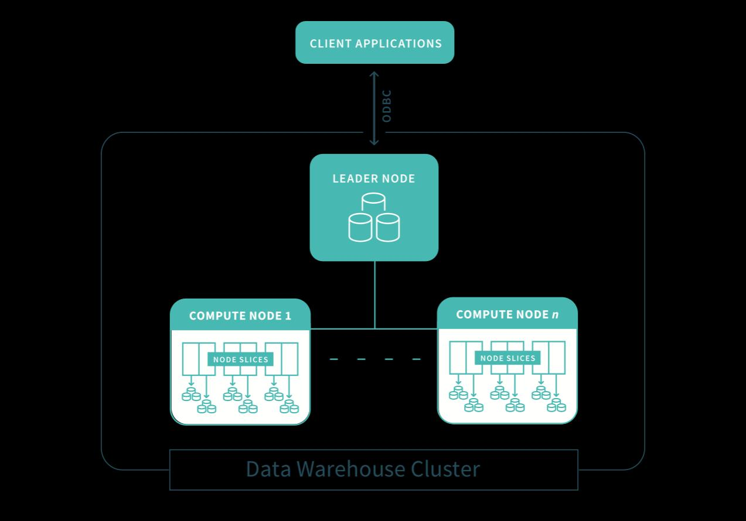
Data warehouse cluster

Slide 13
Conclusion
In conclusion cloud data warehouse is a great way to store data files.its convient, reliable,and secure.you can access your files from anywhere and you don’t have to worry about losing them if something happens to your computer
Notes:
In conclusion cloud data warehouse is a great way to store data files.its convient, reliable,and secure.you can access your files from anywhere and you don’t have to worry about losing them if something happens to your computer

